Slide 1
Optimization Algorithms / Stochastic Gradient Descent
Darshan Patel – Deep Machine Learning Spring 2019

Slide 2
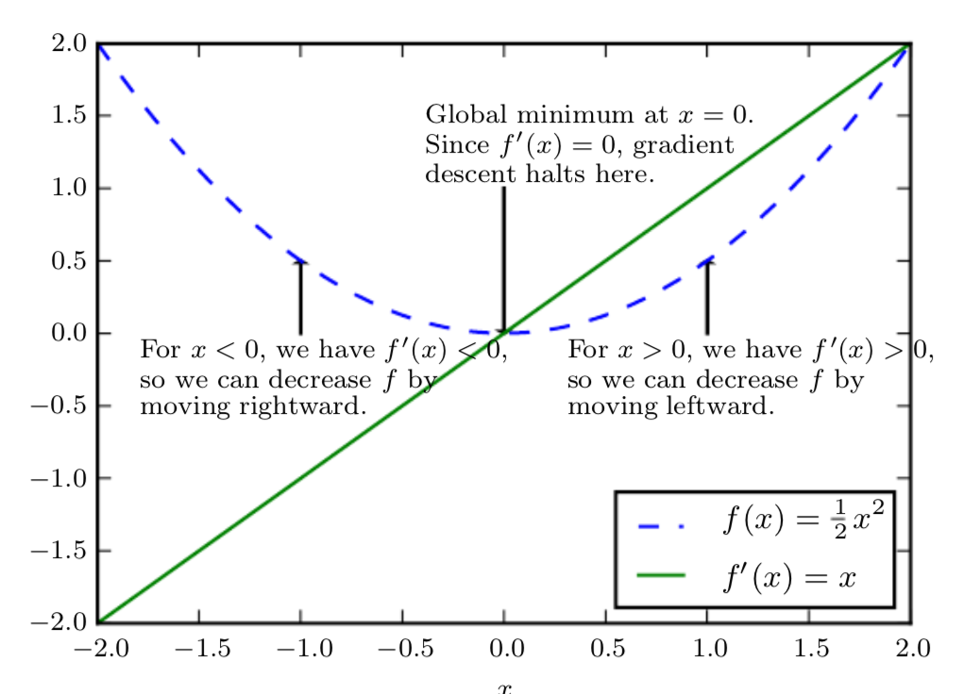
What is Optimization?
In deep machine learning, optimizing is the task of minimizing an objective/loss function
One simple optimization algorithm is gradient descent that utilizes slope/gradient and small steps, called the learning rate

Slide 3
Stochastic Gradient Descent
Same concept as gradient descent but this time, use a single training point or a small mini-batch of points

Slide 4
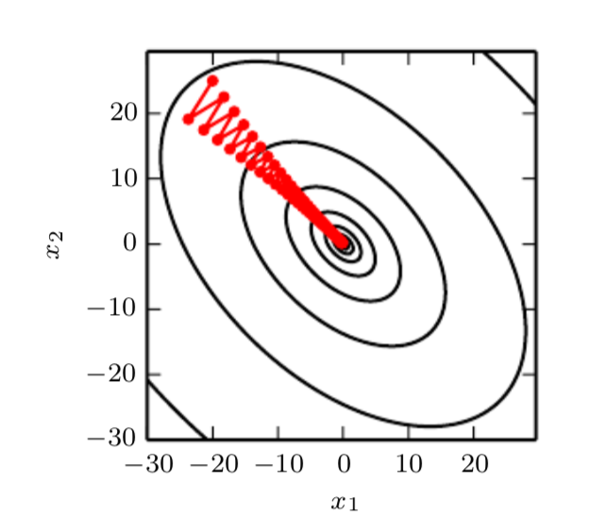
Advantages of Stochastic Gradient Descent
Easier to find gradient of a single point, or small batches of points, rather than thousands on points
Faster convergence on large datasets

Slide 5
Limitations and Design Issues
Choice of learning rate
Local minimas vs global minima
Fluctuation in loss from epoch to epoch

Slide 6
What if the learning rate could “adapt”?
Stochastic gradient descent keeps a constant learning rate
Use methods such as: AdaGrad , RMSProp , AdaDelta
This improves stochastic gradient descent!

Slide 7
Applications
Useful for classification problems where decision boundaries need to be found
Image recognition, ex: MNIST, ImageNet (which has 1.2 million training images)

Slide 8
Video of Optimization
https://www.youtube.com/watch?v=yxNB4DOV4C4

Slide 9
Conclusion
Neural networks require cost functions which require optimization algorithms to find the best results
Stochastic gradient descent is one option, but can be improved on using ways to find the best learning rate

Slide 10
References
Chollet, F. (2018). Deep learning with Python. Shelter Island, NY: Manning Publications. pg 48 – 51.
Goodfellow, I., Bengio, Y., & Courville, A. (2017). Deep learning. Cambridge, MA: The MIT Press. pg. 83 – 85.
https://towardsdatascience.com/types-of-optimization-algorithms-used-in-neural-networks-and-ways-to-optimize-gradient-95ae5d39529f
http://ruder.io/optimizing-gradient-descent/index.html

